Slide 1

Photonics-Empowered Computing
— From Efficient to Functional Data Movement
Yuyang Wang
Postdoctoral Research Scientist, Columbia Nano Initiative
Columbia University in the City of New York, New York, NY 10027
🖂 yw3831@columbia.edu
January 20, 2025

Slide 2
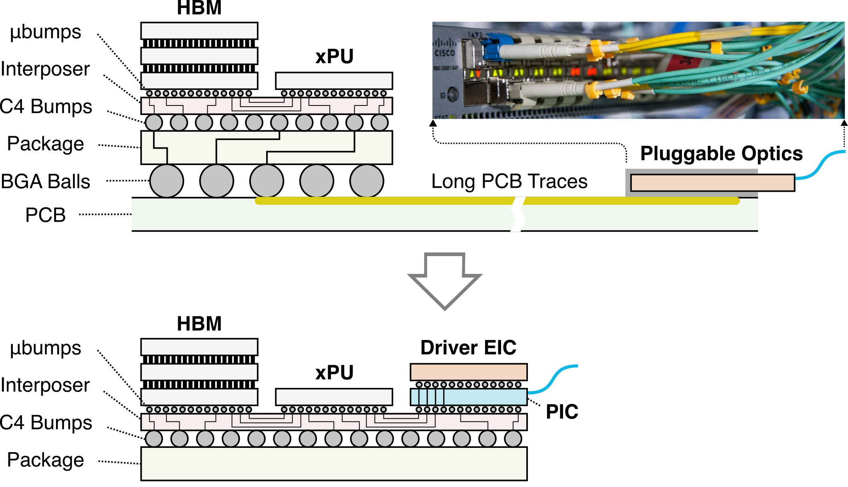
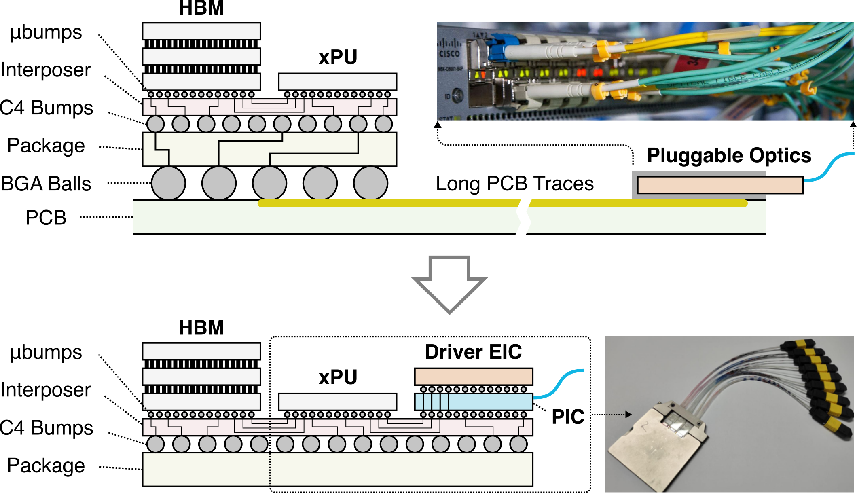
Bringing Photonics into Computing Sockets
Today’s optical connectivity:
My research:

Slide 3
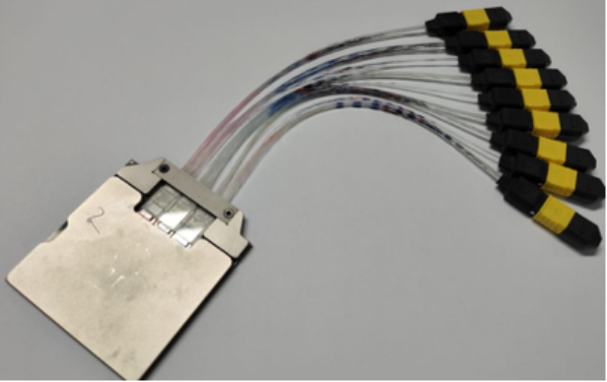
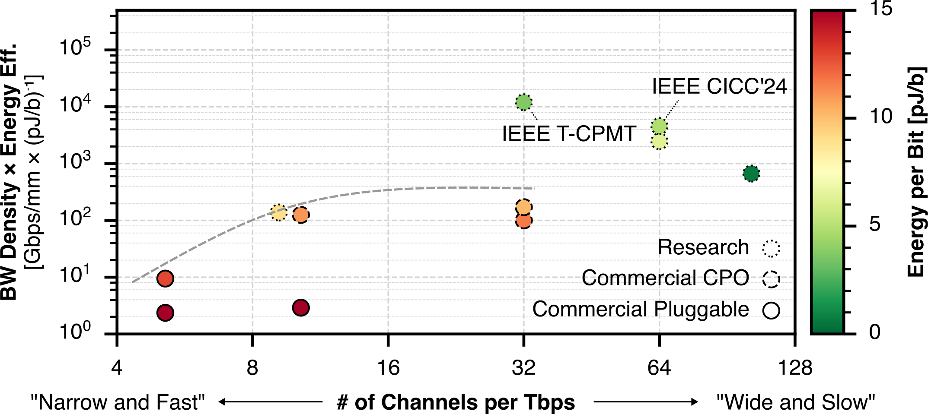
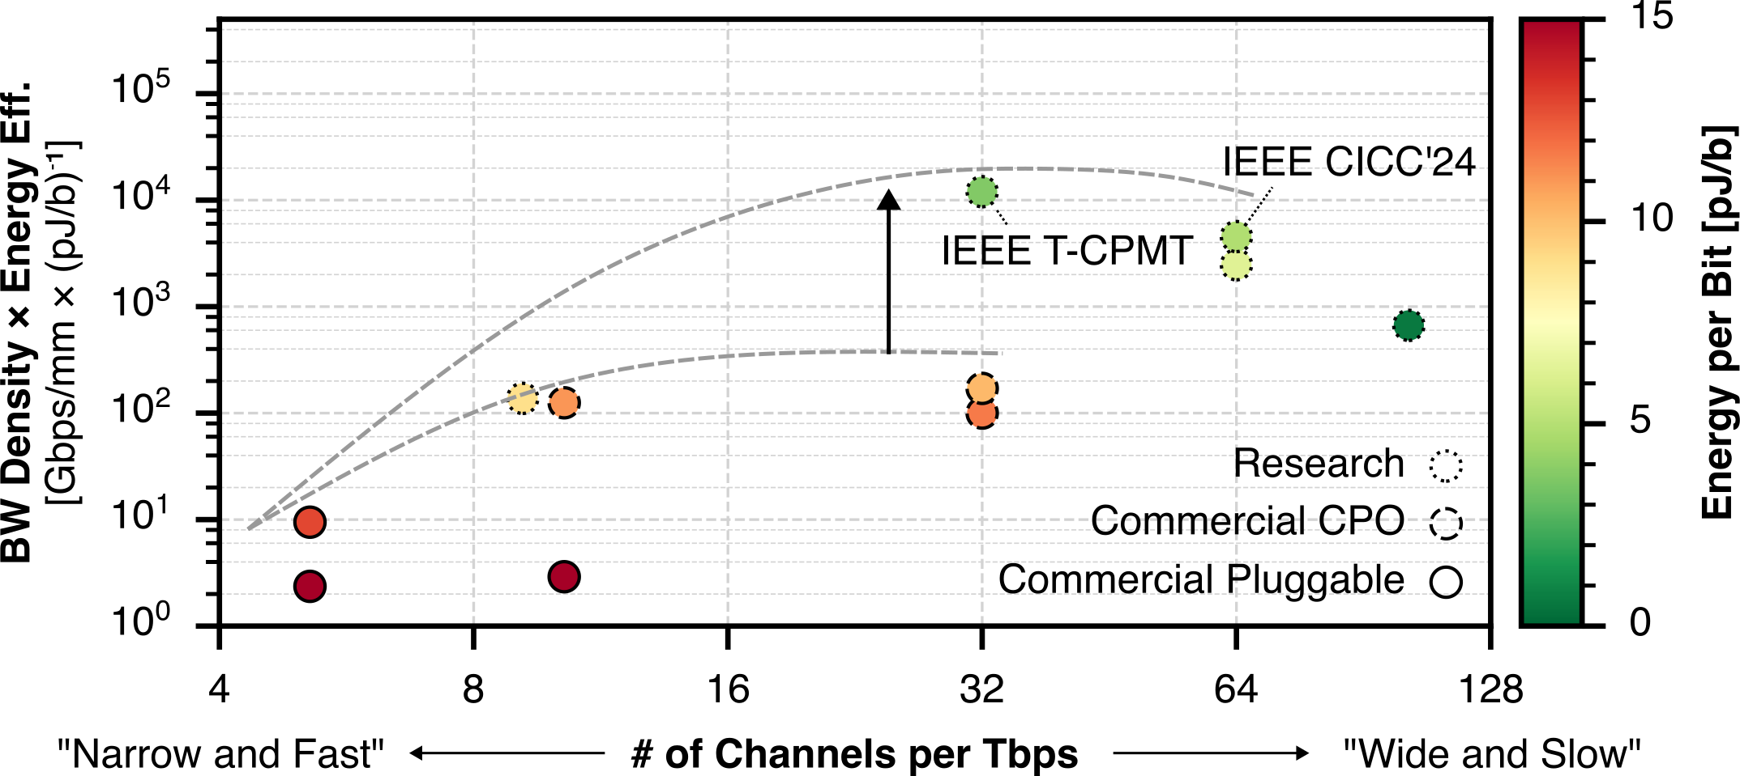
High-Bandwidth Density Energy-Efficient Data I/O
100x
Prior work
96 Tb/s bidirectional
4 Tb/s/mm shoreline
< 1 pJ/b energy

Slide 4
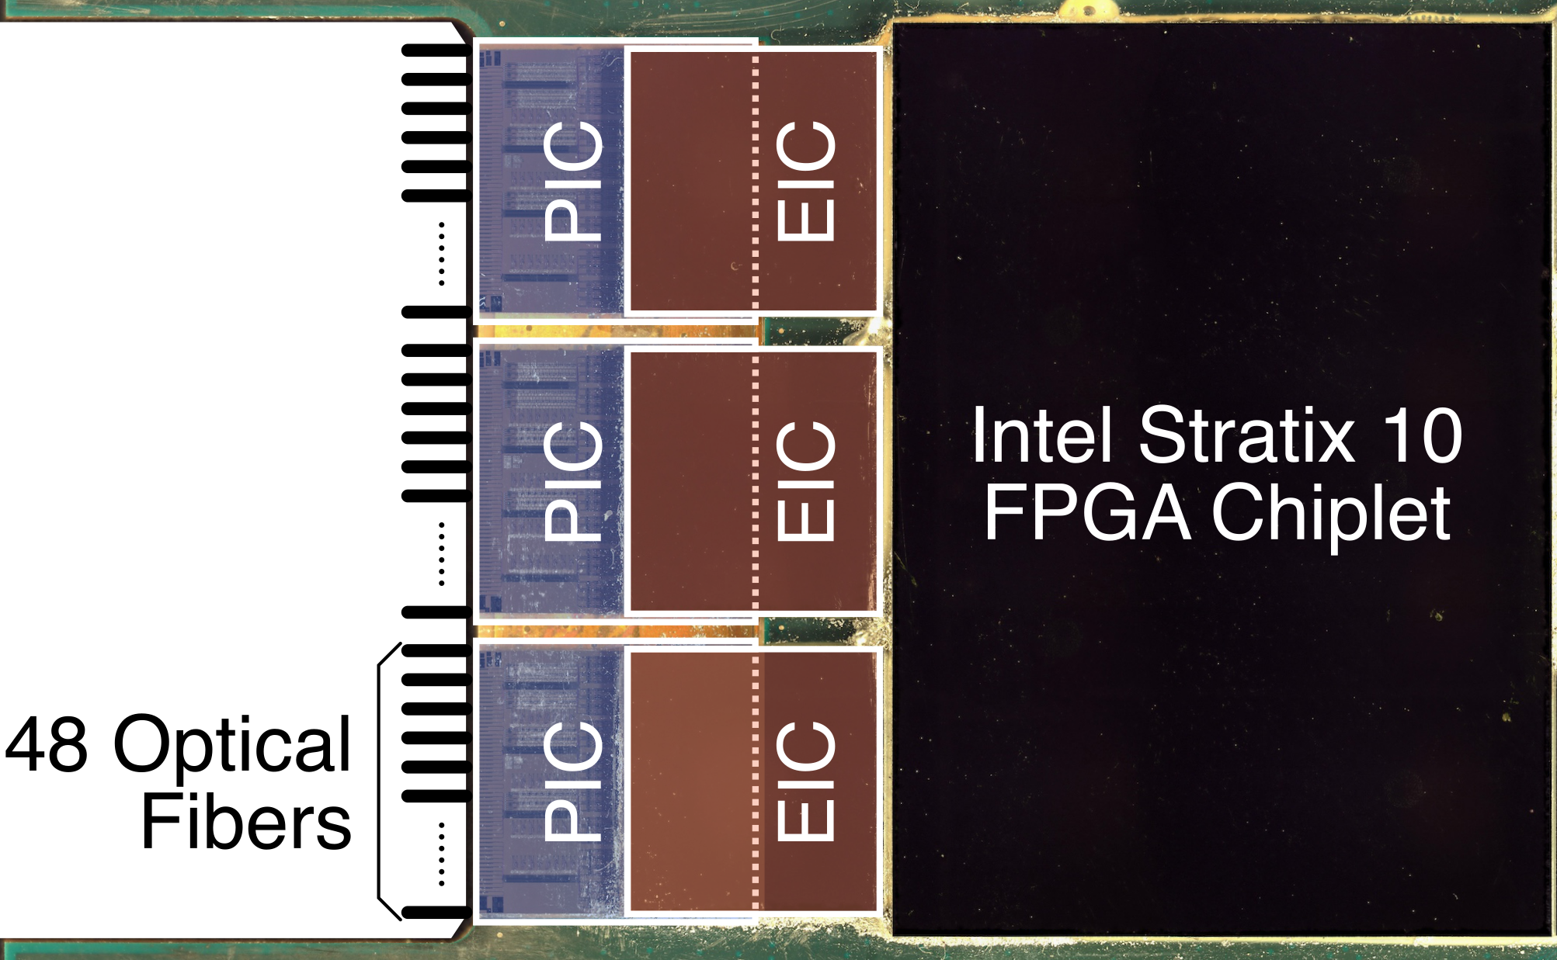
Hybrid 2.5D/3D Integration
PIC: My work
EIC: Cornell
Package: Intel

Slide 5
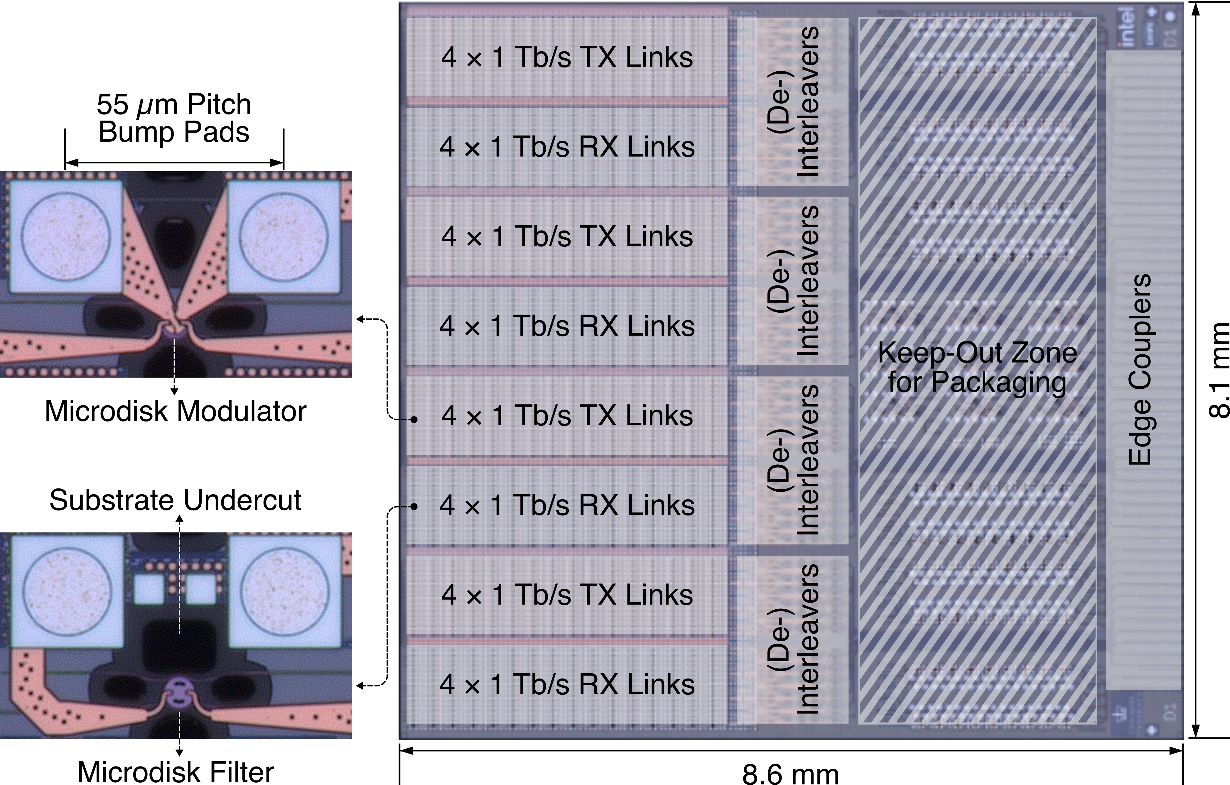
Photonic Chip Design for Packaging

Slide 6
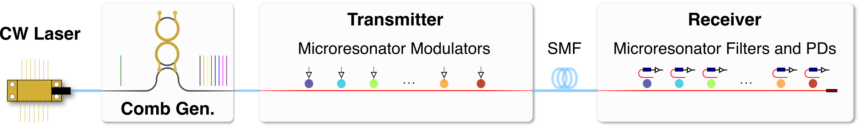
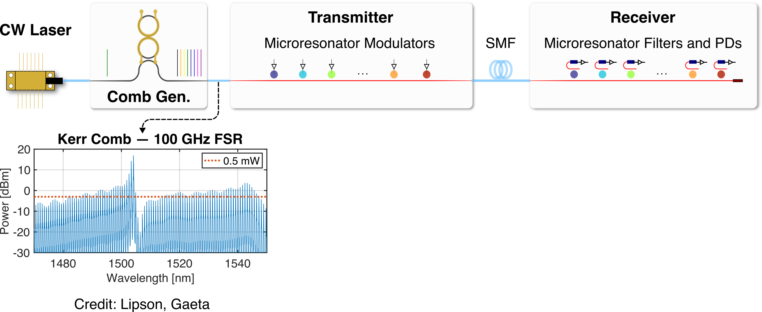
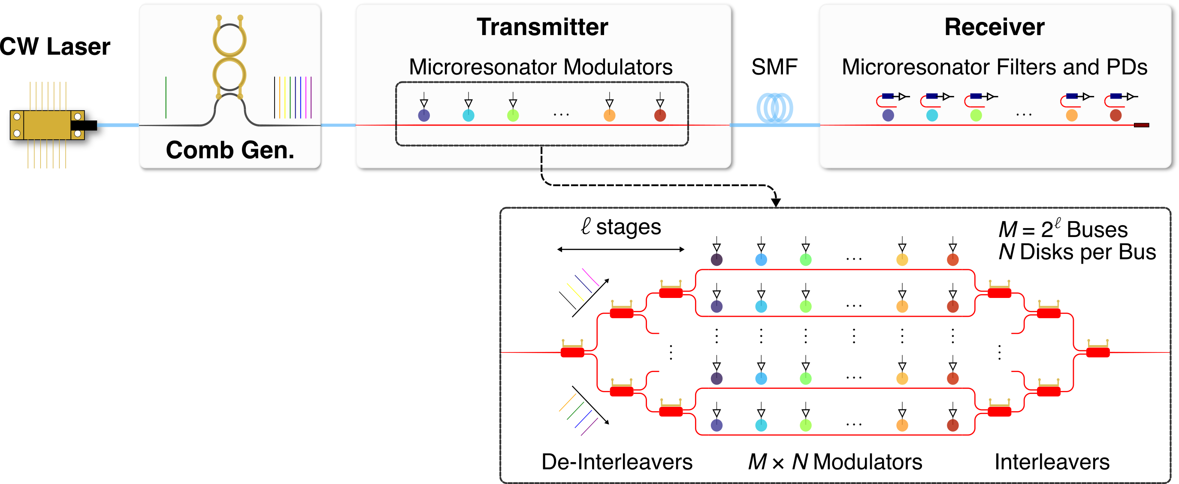
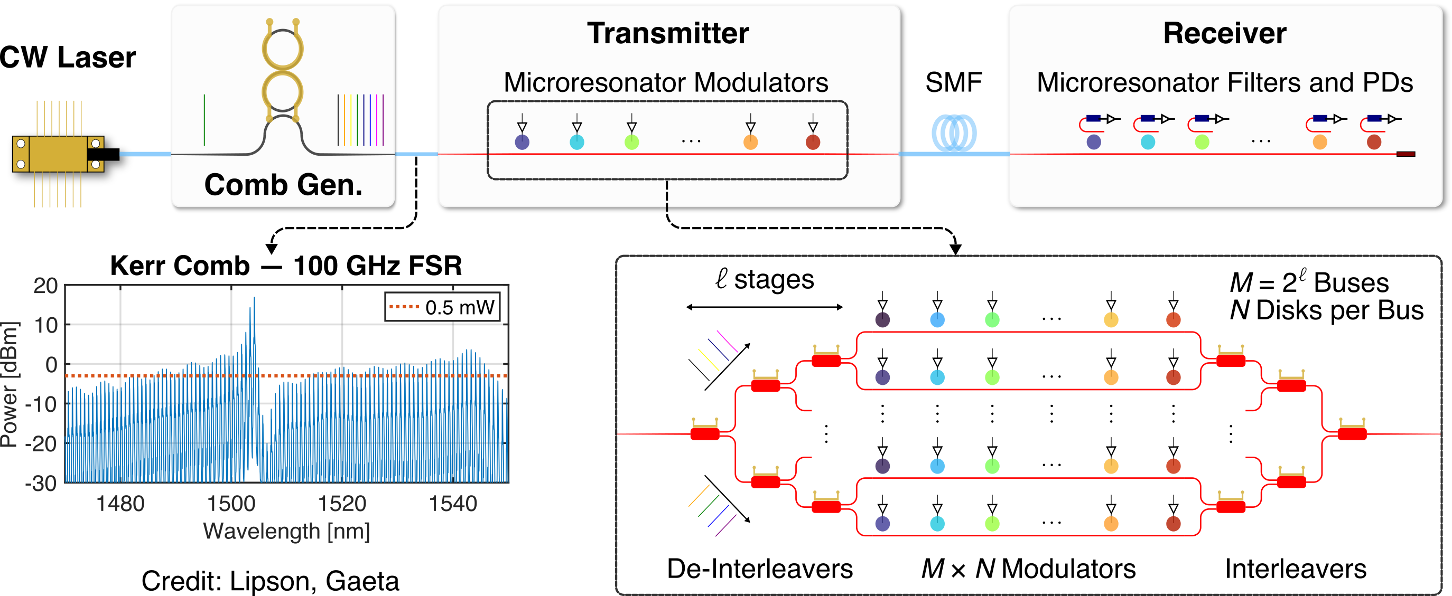
Scalable Link Architecture: Massive Wavelength Parallelism
# of wavelengths per link: from today’s less than 16 to greater than 64
High aggregate bandwidth with moderate data rate per channel

Slide 7
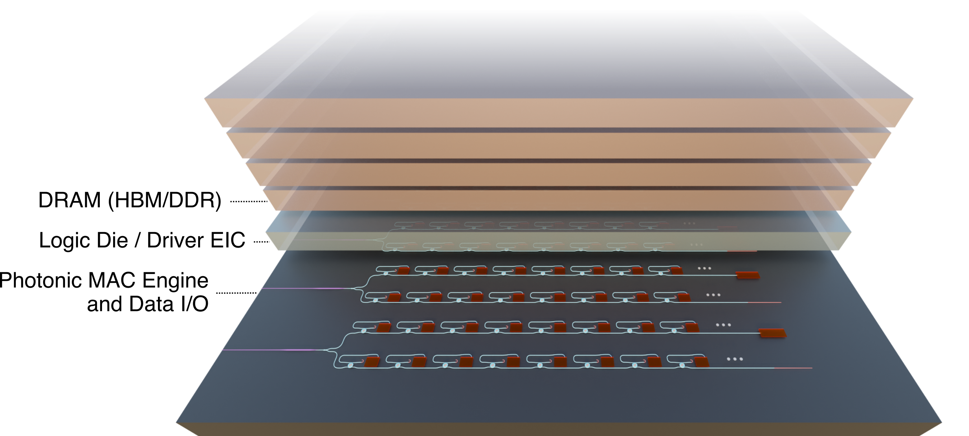
Computing within Data Movement

Slide 8
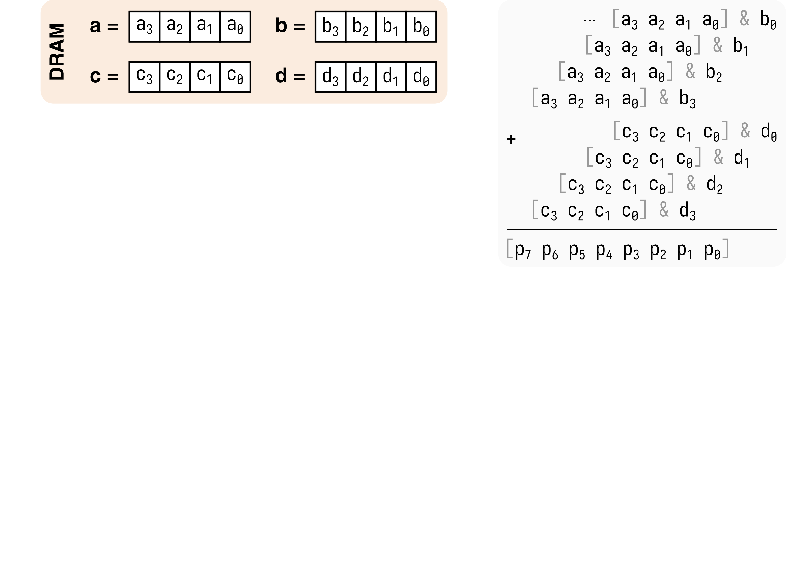
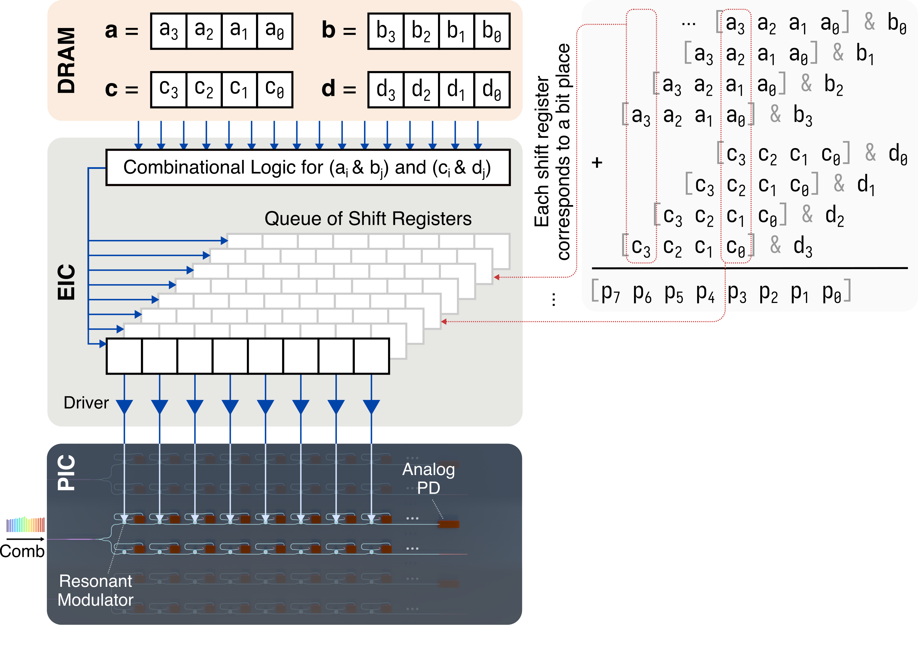
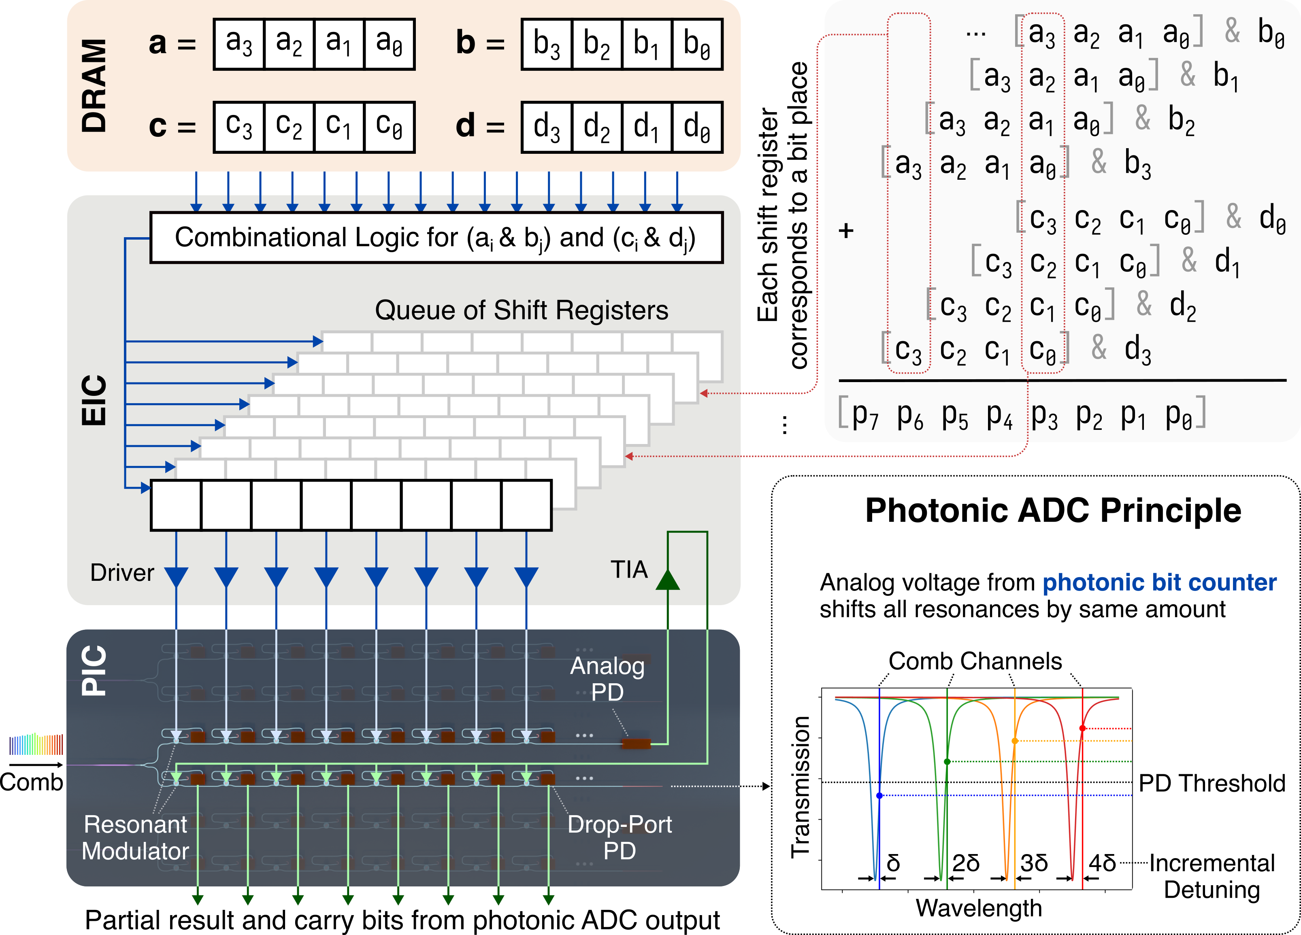
Photonic MAC Operation with Full Digital Precision
Existing Photonic MAC
Computes in analog domain
Extra DAC and ADC steps
Limited precision
My Approach
One wavelength per bit place
Counts # of 1’s instantaneously
Partial results and carry bits from photonic ADC
Retains full digital precision

Slide 9
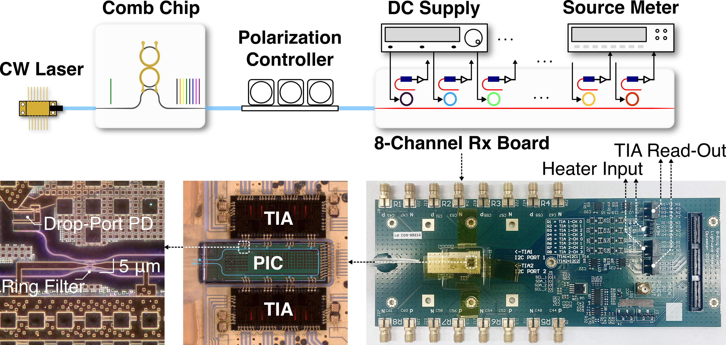
Hardware Validation of Photonic MAC Architecture

Slide 10
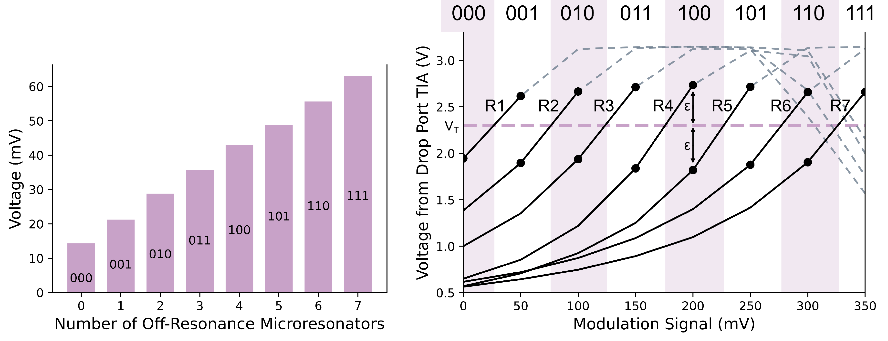
Photonic Bit Counting and ADC
# of 1’s → Voltage
Amplified Voltage → Digital

Slide 11
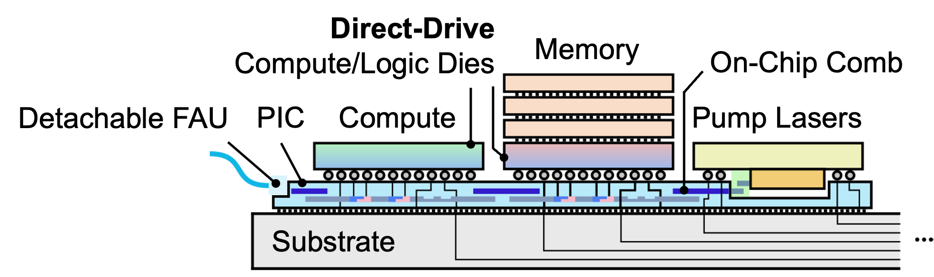
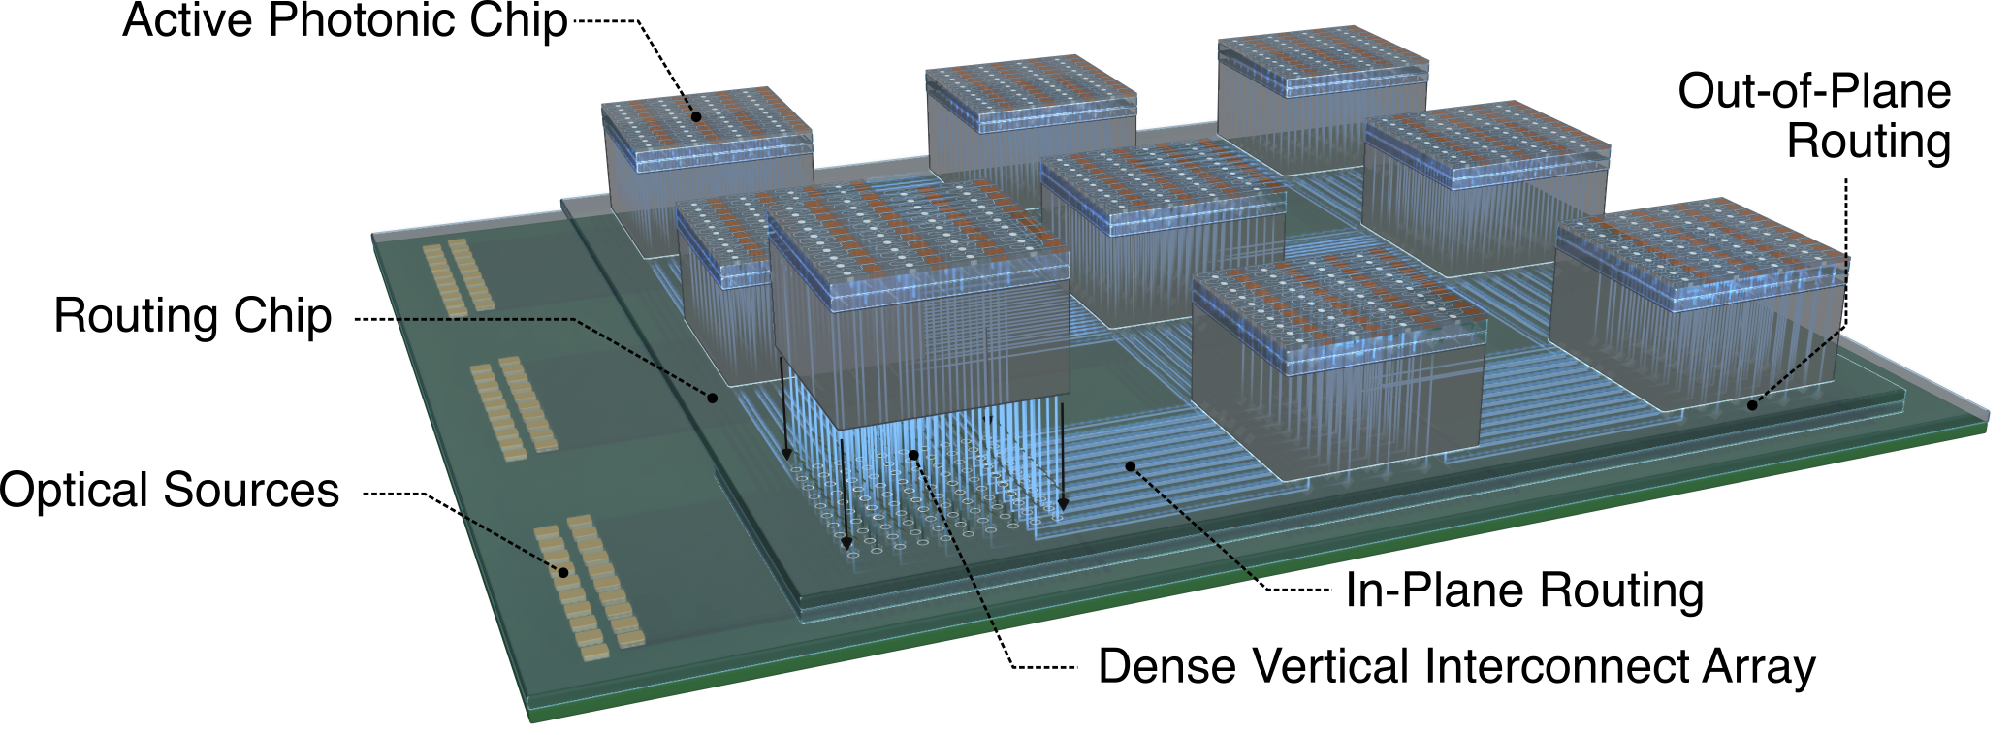
Future Directions
Heterogeneous Integration
Integrated comb source
Direct-drive photonics
3D Photonic Connectivity
Break planar photonics limitations
Wafer- / Panel-scale computing
Network-Application Co-Design
Acceleration and energy saving
Diverse application, e.g., RF
Collaborations
Materials and devices (Frank Fan)
Photonics for RF (Kitchen)
Electronic-photonic co-design (Zeinolabedinzadeh)
Modeling, “digital twins”, for advanced packaging (Bailey)

Slide 12
Thank you!

